Slide 1
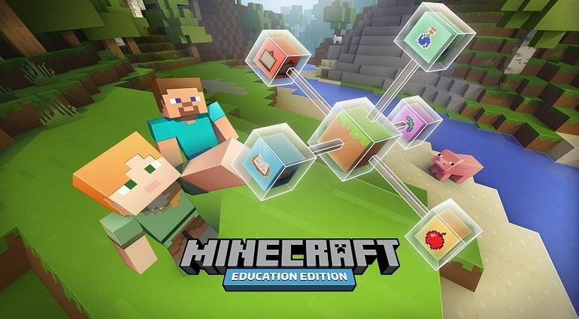
Minecraft: Education Edition
Kristy Herlihy

Slide 2
What is Minecraft?
Minecraft is a game where you dig and build different kinds of 3D blocks within a large world of varying terrains and habitats to explore
It is an independent computer game and virtual world environment designed in 2009
It now has over 100 million registered users

Slide 3
How can Minecraft be used in schools?

Slide 4
Minecraft has open possibilities and potential.
The teacher can choose how he or she wants to use Minecraft.
It provides a customized modification of the game, that helps facilitate organization and focus for teachers to use Minecraft effectively.

Slide 5
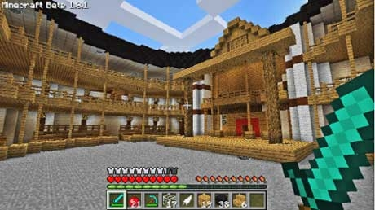
Ways to Use Minecraft in the Classroom
1) Explore Real Life Buildings
There are many already-created structures that you can import into the game and have students explore. From the Roman Coliseum to the Globe Theatre, they can wander through and literally see three-dimensional replications of buildings
that are no longer there. You might have students identify aspects of a theater, or use it as a tool for presentations. You can even have students create these models themselves.

Slide 6
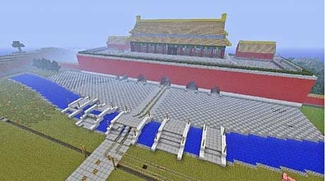
Ways to Use Minecraft in the Classroom
2) Practice Ratio and Proportion
Minecraft allows students to build whatever they want, so use the opportunity to have them create scale models when you need a practice unit about measurements and proportions. The building of scale models might integrate social studies content to allow for cross-curricular connections. Coupled with in-class lessons and activities, Minecraft can help students apply the knowledge they have learned in technological and playful ways.

Slide 7
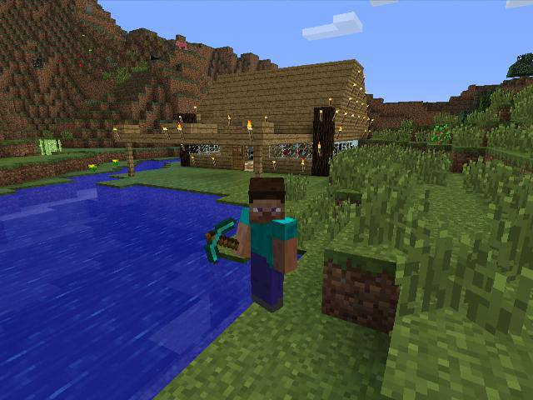
Ways to Use Minecraft in the Classroom
3) Learn about Survival
You can contextualize the concept of survival for students by having them play the survival mode, which demands players take into account resources, hunger, tools and more as they build and expand their world. Students have to explore in order to collect resources, and they have to process what they find, such as smelting ore to create metal. Doing this in the game can give students a basic understanding of how things work, and help them analyze the different components of survival and settlement.

Slide 8
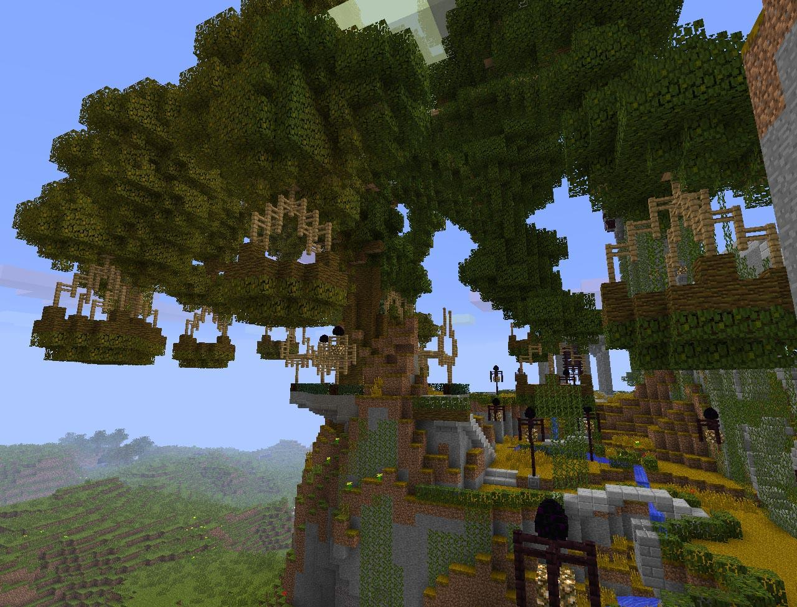
4) Visualization and Reading Comprehension
One of the best ways to improve how students display their reading comprehension is asking them to create a visualization. They could reconstruct various settings from the text, and even recreate scenes and plot events. They could also use these recreations to give a presentation or make predictions on what might happen next, and then physically create those predictions in Minecraft.
Swiss Family Robinson Treehouse

Slide 9
Benefits of Using Minecraft
Teachers can have high expectations from students and be surprised by the outcomes because Minecraft is student centered and open-ended.
Students who come to a lesson using Minecraft as their tool, come with anticipation and excitement
Creating resources, activities and maps for the students is fun and gives the teacher an opportunity to explore creative ideas
Students are very motivated to complete tasks when rewarded with items in Minecraft (who wouldn't want a diamond breastplate!) Students, who were typically off task, were able to demonstrate their understanding of the topic.

Slide 10
Benefits of Using Minecraft
Numerous teacher tools are available including classroom management features, chalkboards, and specialized blocks to enhance learning.
Students love to collaborate.
Students will often extend tasks, adding their own creativity to personalize their end result.
Minecraft caters for a diverse range of students, allowing them to excel, regardless of personal strengths or weaknesses.
There are secure log ins and students can only communicate with other students in the class.

Slide 11
Benefits of Using Minecraft – STEM Learning
Students are learning about such STEM fields such as geology, physics, and biology by creating models of plate tectonics, quantum behavior, and animal cells.
They are applying their understanding of mathematical concepts by using the game’s one cubic meter blocks to measure area, perimeter, and volume, as well as to demonstrate ratios and proportions, fractions, decimals, and percentages. They collect data and graph it in the game.

Slide 12
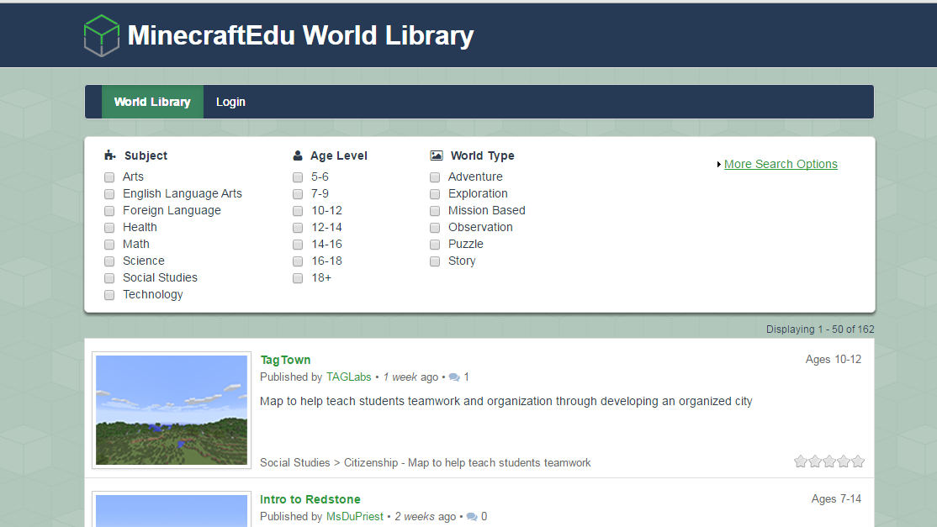
The World Library is where you go to look for worlds that other teachers and students have made that can be downloaded for you to use.
You can search by subject area, age level, and world type.
http://services.minecraftedu.com/worlds/

Slide 13
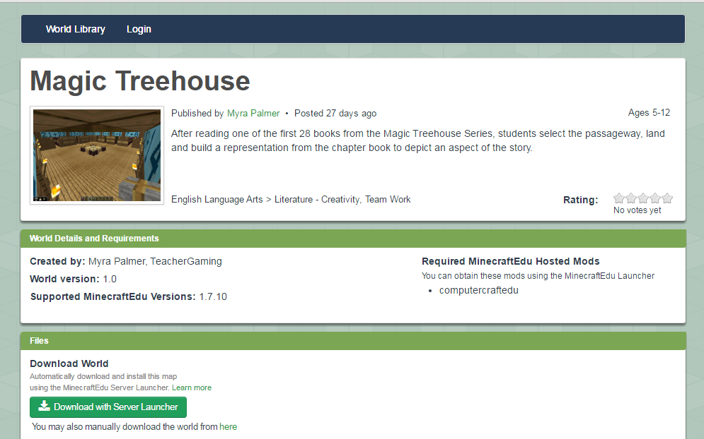
Here is an example of a literacy activity that can be found in the database.

Slide 14
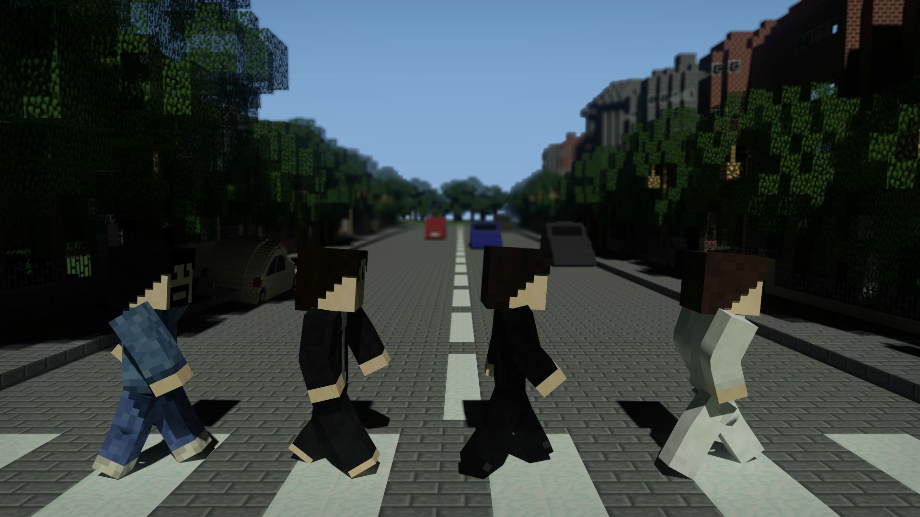
Minecraft creates high levels of engagement and creativity in users.
Students use higher order thinking skills while completing assignments.
Students are deeply engaged in active and creative problem-solving, collaboration, and rich content creation.

Slide 15
Collaborative Learning

Slide 16
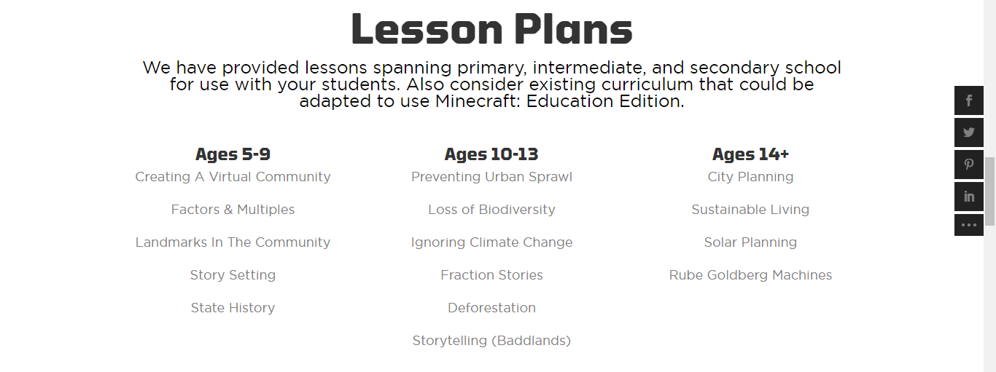
Ages of use
Minecraft is appropriate for ages 5 through adults.
There are pre-made lesson plans available for elementary, middle, and high school levels.

Slide 17
Tangible Learning Outcomes

Slide 18
References
Cordova, D. I., and M. R. Lepper. 1996. Intrinsic motivation and the process of learning: Beneficial effects of contextualization, personalization, and choice. Journal of Educational Psychology 88:715-730.
Gee, J. P. 2003. What video games have to teach us about learning and literacy. New York: Palgrave Macmillan.
Klopfer, E., Osterweil, S., and Salen, K (2009). Moving Learning Games Forward. Educational Arcade. Massachusetts, Massachusetts Institute of Technology: 58.
Malone, T. W. 1981. Toward a theory of intrinsically motivating instruction. Cognitive Science 4:333-369.
Piaget, J. 1962. Play, dreams and imitation in childhood. New York: Norton.

